Slide 1




A Natural Language Interface for Database: Achieving Transfer-learnability Using Adversarial Method for Question Understanding
Wenlu Wang Yingtao Tian Haixun Wang Wei-Shinn Ku
Auburn University Stony Brook University WeWork Research Auburn University

Slide 2
Outline
Motivation
Adversarial Mechanism
Challenge
Method
Experiments

Slide 3
Outline
Motivation
Adversarial Mechanism
Challenge
Method
Experiments

Slide 4

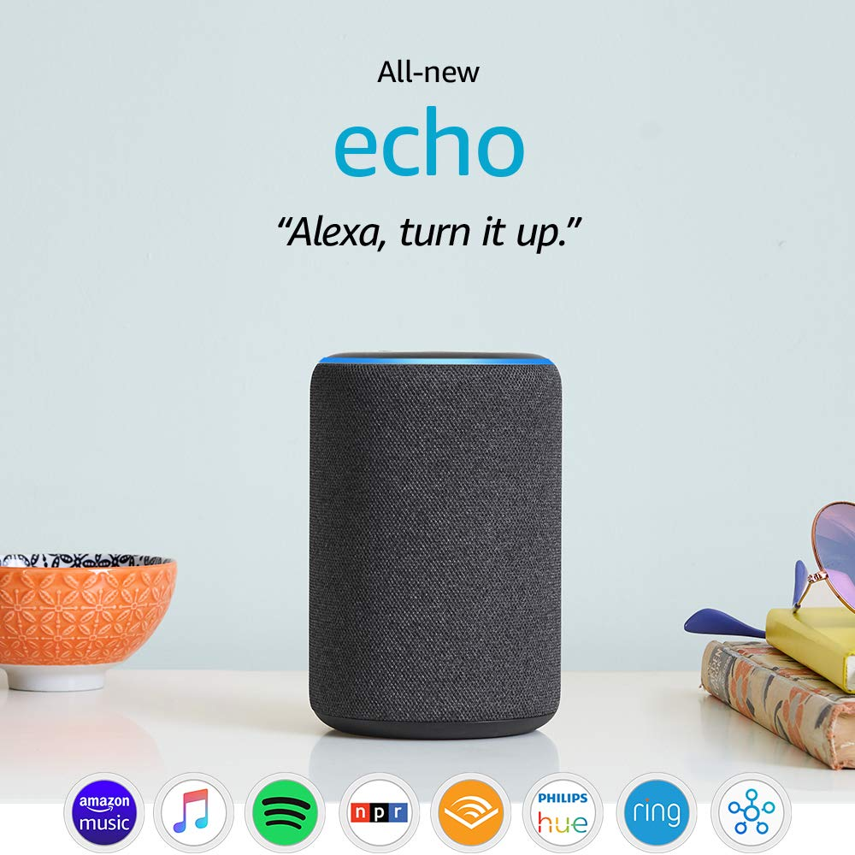
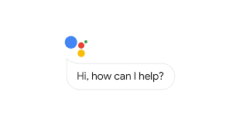
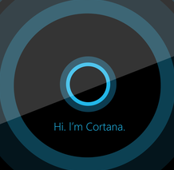
What is NLI ?
Alexa?
Siri?
Check the weather
Play a song for you
Tell you the score of the game yesterday
Google
Assistant?
Cortana?

Slide 5
Can do
Check the weather
Play a song for you
Tell you the score of the game yesterday
Can’t do
Retrieve information you are interested in from the database
Sales manager: sales this month
Doctor: maintain patients’ heath records
Business Analyst: analyze the data

Slide 6
Natural Language Interface (NLI)
Data analysts are overwhelmed with more data they can possibly analyze manually.
It requires certain knowledge to query a database.
Relational DBMS uses SQL.
MongoDB uses JavaScript.
Bridge the gap between human and machine intelligence.

Slide 7
Objective
A Natural Language Interface to DataBases (NLIDB)
Enables data analysts to probe the important trends in a dataset
Supports data analysis across domains/datasets
We focus on transfer learning instead of
Speech recognition
Standard Question-answering (QA)
Dialogue systems

Slide 8
Definition
An NLIDB (in this work)
Understands a natural language question semantically
Translates the question to query language
Retrieves correct information from databases

Slide 9
Outline
Motivation
Adversarial Mechanism
Challenge
Method
Experiments

Slide 10
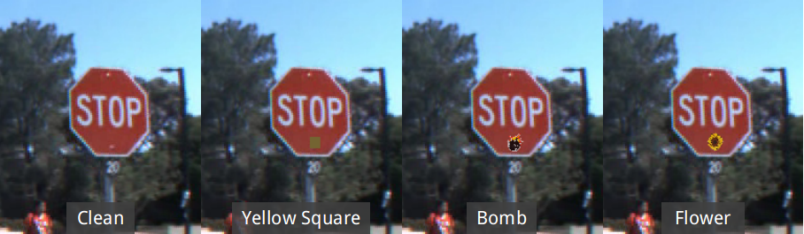
Adversarial Attack
[Backdoor] Figure from BadNets (Gu, et al. ‘17)
[Watermark] The adversarial images (2nd row) are generated from the 1st row.
The label of each image is shown below with prediction probability in parenthesis.

Slide 11
Adversarial at Test Time
Given
A classifier
A carefully chosen perturbation [watermark]
An adversarial example for is where
Notes:
Since most of the times, adversary could not control the training process. Like I mentioned earlier, adding a backdoor is hard unless you work for Tesla.
Most of the security issues arises at test time.
Supposing we have a classifier f, the attacker can find a carefully chosen small perturbation epsilon,
The perturbation will trick the model to make a false prediction (like the watermark attack).
So I will focus on watermark attack here.

Slide 12
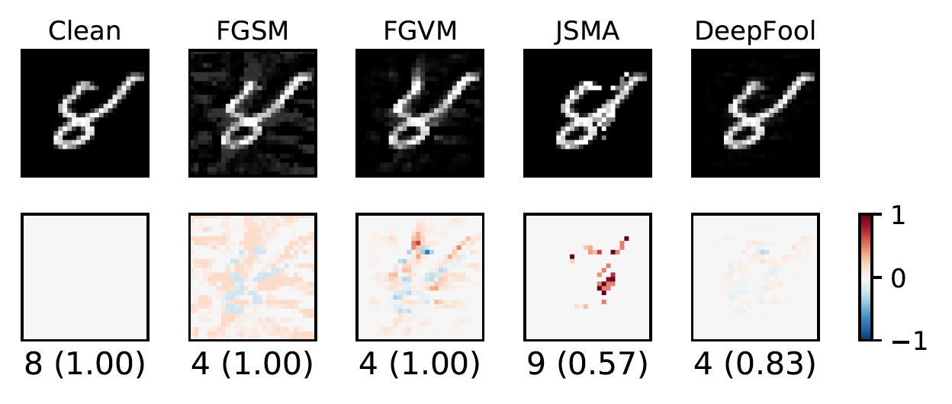
Watermark Adversarial Mechanism
Adversarial direction is very influential towards prediction.
Notes:
There are several watermark adversarial attacks algorithms.
The heatmap represents the watermark, which is also the adversarial direction.
As we can see, all the adversarial attacks are trying to make perturbations towards the most influential directions.
Inspired by such idea, we propose to use adversarial mechanism to address the transfer-learning challenge.

Slide 13
Outline
Motivation
Adversarial Mechanism
Challenge
Method
Experiments

Slide 14
Challenge
Deep model does not support direct domain transfer
A model trained to answer
What is the height of LeBron James?
SELECT height WHERE player = LeBron James
Can not answer
What is the population of NYC ?
SELECT population WHERE city = NYC

Slide 15
New Strategy
A model trained to answer
What is the height f0 of LeBron James v1?
SELECT f0 WHERE f1 = v1
SELECT height WHERE player = LeBron James
Can answer
What is the population f0 of NYC v1?
SELECT f0 WHERE f1 = v1
SELECT population WHERE city = NYC

Slide 16
Main Idea
Intuitive strategy
Explicate the idea of maximizing domain-specific loss.
Empirical Method
Remove domain-specific knowledge by replacing domain-specific knowledge with pre-defined symbols so that different domains would share the same symbols and same SQLs.
Notes:
In summary,
So that domain knowledge will not be a signal for prediction.

Slide 17
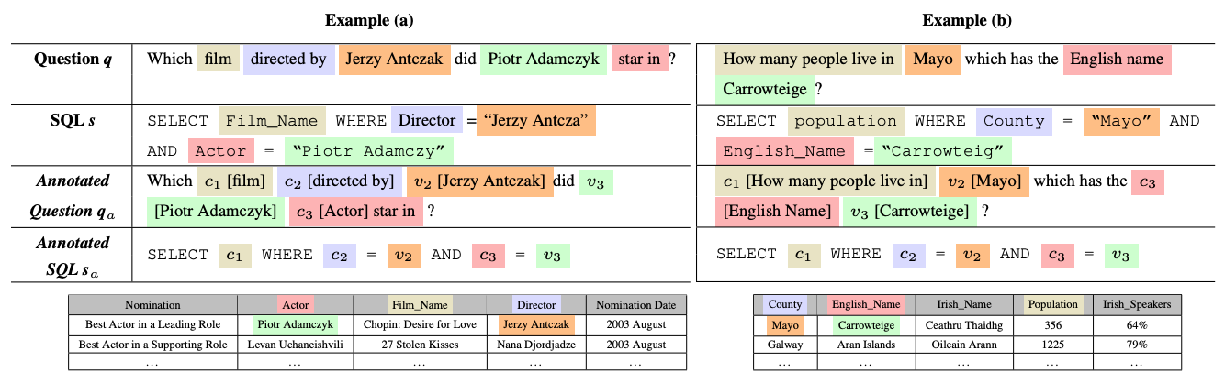
Observation
Film Domain
Census Domain
Domain-Specific Knowledge
Notes:
I have made some progress for transfer learning.
The two questions are asking about two different domains. One is asking about films and the other is asking about census data.
We are surprised to see that even the two questions have different pattern different semantics and difference name entities.
The final SQLs are very similar.
Such phenomenon inspired us to make a reasonable assumption that we are able to produce a NLI that supports multiple domains.
The assumption is based on two factors:
The output space is relatively small and shareable among multiple domains.
The input space is only natural language questions.

Slide 18
Outline
Motivation
Adversarial Mechanism
Challenge
Method
Experiments

Slide 19
Design
We remove domain-specific knowledge by sequential tagging.
Question Which movie were scheduled to released on January 4, 2019?
Question Which <f0> were scheduled <f1> <v1> ?
Data elements
<f0> movie
<f1> release date
<v1> January 4, 2019
Query SELECT <f0> WHERE <f1> EQUAL <v1>
Query SELECT movie WHERE release date EQUAL January 4, 2019
Contextual semantic match ???
Movie | Director | Release Date
Escape Room | Adam Robitel | January 4, 2019
… | … | …
Notes:
In our empirical design, We Remove domain-specific knowledge by sequential tagging.
Assuming table is known, we will replace all schema-specific information with pre-defined symbols.
Reduce the burden for deep models to learn the domain-specific knowledge.
In this way, we are no longer looking at the schema-specific information, we are only looking at symbols.
However, implementing such tagging strategy is non-trivial.
Exact match does not work. We have to rely on deep model.

Slide 20
Sequential Tagging
Question Which movie were scheduled to released on January 4, 2019?
Question Which <f0> were scheduled <f1> <v1> ?
Data elements
<f0> movie
<f1> release date
<v1> January 4, 2019
Semantic match ???
Movie | Director | Release Date
Escape Room | Adam Robitel | January 4, 2019
… | … | …
Notes:
Remove domain-specific knowledge by sequential tagging.
Assuming table is known, we will replace all schema-specific information with pre-defined symbols.
Reduce the burden for deep models to learn the domain-specific knowledge.
In this way, we are no longer looking at the schema-specific information, we are only looking at symbols.
However, implementing such tagging strategy is non-trivial.
Exact match does not work. We have to rely on deep model.

Slide 21
Contextual Understanding
Notes:
We train this contextual understanding binary classifier using training data.
In other words, how do I know ``Release Date’’ is mentioned as ``to release on’’?
Bidirectional attentive workflow
I will input both the question and the name entity.
The benefits of this model structure is that we were trying to understand the Name Entity “column date” while attending on the whole question.
We call it contextual understanding since all the tokens are taken into consideration in a weighted manner.

Slide 22
Okay, I know a
domain-specific keyword
is mentioned. How do I
know where to tag?
Intuitive: the phrase that mentions “Release Date” should be the most influential to the prediction.
Notes:
We train this contextual understanding binary classifier using training data.
In other words, how do I know ``Release Date’’ is mentioned as ``to release on’’?
Bidirectional attentive workflow
I will input both the question and the name entity.
The model will go through each token in the question while attending on the name entity.
Such structure enables contextual understanding since all the tokens are taken into consideration in a weighted manner.

Slide 23
Okay, I know a
domain-specific keyword
is mentioned. How do I
know where to tag?
What
mission
February
Intuitive: the phrase that mentions “Release Date” should be the most influential to the prediction.
Notes:
As I mentioned earlier, the adversarial direction should be the most influential direction.
In this example, “to release on” should be the most influential towards the prediction.
A slight change on “to release on” should be a strong signal for different classification.
For example, if I change “movie” to “mission”, the prediction will probably the same.

Slide 24
Adversarial Mechanism
Adversarial direction is most influential towards prediction.
Instead of doing actual adversarial attack,
we borrow the idea of searching for the most influential direction.
Adversarial Direction
FGVM attack
find the most influential direction using Fast Gradient Method (dL/dx)
Perturb along the direction until an adversarial sample is generated (e.g., Prediction 8 is changed to 4).
*We only use step (1) for searching “to release on”.

Slide 25
Influential Level
For each token , we calculate its influential level, which is defined as follows
Taking -norm as an example
Notes:
We define a concept “influential level” to detect which words are the most influential.
The difference is, unlike image domain, we are dealing with text, the text space is discrete and not smooth.
So we have to convert it to a smooth space.
Inspired by FGM, we use the l-2 norm of the gradient of the loss function to indicate the influential level.

Slide 26
Real Case Studies
Notes:
Here are the examples of Influential Level. Those are real questions from WikiSQL.
As we are can see, the influential level is able to pinpoint where the entity is referenced in the question.

Slide 27
Outline
Motivation
Adversarial Mechanism
Challenge
Method
Experiments

Slide 28
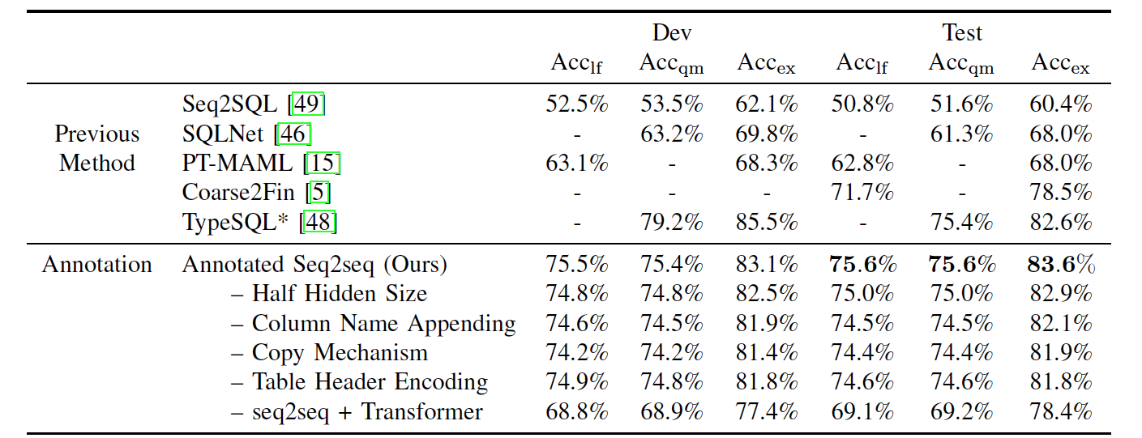
Experiments
Comparison of models. Lf, qm, ex represents logical forms, exact query match, and query execution accuracy, respectively. “+” and “-” mean removing or adding one component from our best approach respectively for ablation.
Notes:
Our strategy achieves good results by using a simple bi-directional attentive workflow.

Slide 29
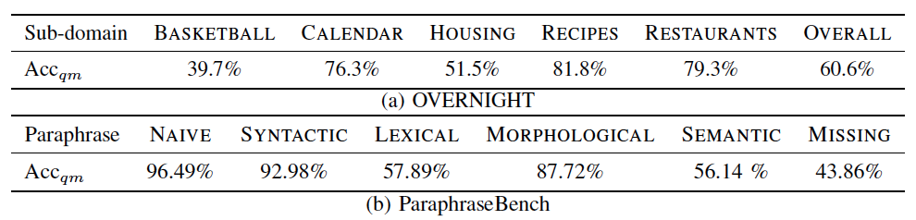
Zero-shot transfer-ability
Transfer Accuracy
Notes:
The zero-shot learning means the model has never the seen the domain before, and we combine both training and testing sets as the evaluation set here.
Since in this work, we focus on domain compatibility instead of the variations of natural language expressions.
The transfer accuracy is calculated over sketch-compatible records and non-compatible records/operations are discarded.
We observed that our model shows robust transfer-ability with zero-shot learning, and even for different datasets.

Slide 30
Thank you!

